Slide 1
A Performance Benchmark for Antidote
Guided By : Deepthi Akkoorath
Presented by : Alka Scaria, Vishnu Vardhan Sundarrajan, Tchangou Maxime, Kevin Bartik

Slide 2
Task Description
Develop a benchmarking solution for Antidote that allows to compare different versions of Antidote
Work – load generated should be suitable to compare the performance of different parts of Antidote
Generate a result file visualizing
Benchmarking tool should take as input a commit-id/branch name of the Antidote GitHub repository

Slide 3
STEPS

Slide 4
Step 1 – Identifying Major Components
Output (Graph)
Antidote
Input
Benchmarking Tool
Input
Visualization
Docker

Slide 5

Step 2 – Decision Making
Programming Language
Operating System
IDE
Benchmarking Tool
Java
Windows
IntelliJ
Basho Bench
Erlang
Linux
Eclipse
YCSB
JMeter

Slide 6
Step 3 - Architecture
Antidote Container
Antidote Client
Antidote Client Wrapper
YCSB
YCSB Client
Visualization of the Result
Docker
Docker Manager

Slide 7
Outline
Docker Manager
Antidote Client Wrapper
Benchmarking using YCSB
Visualization of Results

Slide 8
Docker Manager (1/4)
Docker management was difficult using Docker-Compose and CLI
Goal: We wanted something that integrated well with the project
Solution: Docker Java API (Spotify Docker Client)
Benefits: Allows us to interact with Docker containers dynamically at runtime

Slide 9
Docker Manager (2/4)
We used a modified version of the Antidote Docker Image
Goal: Rebuild Antidote quickly for benchmarking different versions
Problem: Regular Image building takes several minutes
Solution: Rebuild Antidote in running container with original files

Slide 10
Docker Manager (3/4)
We used a modified version of the Antidote Docker Image
Benefits: Rebuilding Antidote inside the container takes only a few seconds
Problem: Antidote Dependencies may cause issues because our build is not clean!
Solution: Make sure that Antidote is in a valid state* and rebuild clean if necessary
*not fully implemented yet

Slide 11
Docker Manager (4/4)
Uses of the implementation
All basic interactions with containers (run, start, stop, remove)
Building our special Antidote Benchmark Image
Executing commands directly on the container (like rebuilding Antidote in the running container)
Ensuring that the Antidote database is in a valid state before running benchmarks

Slide 12
Benchmarking using YCSB (1/2)
What is YCSB?
YCSB – Yahoo! Cloud Serving Benchmark
YCSB is a framework for bench-marking systems. The primary goal of YCSB is to develop framework and common set of workloads to evaluate the different ‘Key – value’ and ‘Could’ serving stores.
YCSB mainly benchmarks the throughput and latency of the database operation.
We have to create the DB interface layer to add any new database. This interface layer will have few operations(Insert, delete, update,scan) available in YCSB.

Slide 13
Benchmarking using YCSB (2/2)
YCSB helps to benchmark the database using workloads. There are six different core workload available in YCSB. Also we can create customized workload to run benchmark. Below are the few workload properties:
readproportion, updateproportion,maxscanlength,exportfile,etc.,

Slide 14
Antidote Client Wrapper (1/2)
Interface between Antidote Database and any Benchmarking Tool
In the Antidote Client Wrapper
Start the Container
Get the HostPort
Start the Antidote Client
Read and Write Operations

Slide 15
Antidote Client Wrapper (2/2)
Antidote Client Wrapper
Operations
Single Read
Single Write
List of Read
List of Write
Combination of Read & Write
Read – Read List
Write – Update List
Fetches
YCSB Client
Public Status update(String table, String key, HashMap<String, ByteIterator> values)
{ ……..
}
YCSB DB
public abstract Status delete (String table, String key);
public abstract Status update (String table, String key, HashMap<String,ByteIterator> values);

Slide 16
Visualization of Results (1/7)
JFreeChart for the Visualization of Results
What is JFreeChart?
What kind of graphs can be modeled with JFreeChart?
What kind of Output-files can JFreeChart support?
Code example for a XY-Chart

Slide 17
Visualization of Results (2/7)
What is JFreeChart?
JFreeChart as a free 100% Java chart library

Slide 18
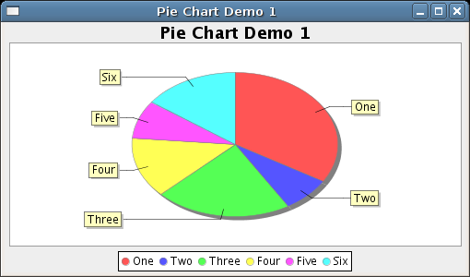
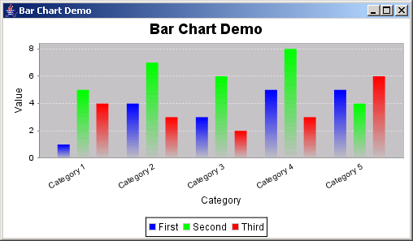
Visualization of Results (3/7)
What kind of graphs can be modeled with JFreeChart?
- Pie Chart
- Bar Chart

Slide 19
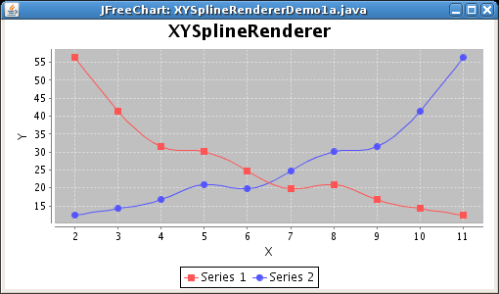
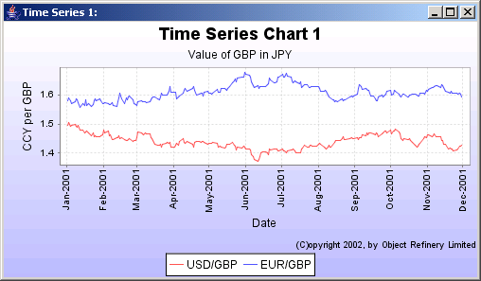
Visualization of Results (4/7)
What kind of graphs can be modeled with JFreeChart?
- XY Chart
- Time Series Chart

Slide 20
Visualization of Results (5/7)
What kind of Output-files can JFreeChart support?
Swing and JavaFX
PNG and JPEG
PDF, EPS and SVG

Slide 21
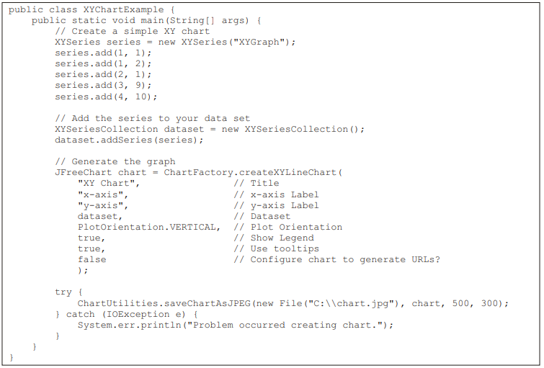
Visualization of Results (6/7)
Code example for a XY-Chart

Slide 22
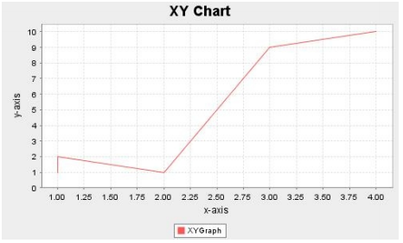
Visualization of Results (7/7)
Output: → The following Graph

